Slide 1
CONQUERING FASHION MNIST WITH CNN’S USING COMPUTER VISION
TEAM NAME - CODERED
MEMBERS - JENAT CICI ANIL
Date of submission – 15th July 2023

Slide 2
ABSTRACT
Conquering Fashion MNIST with CNN using computer vision has been a significant achievement in the field of image classification. The Fashion MNIST dataset consists of 60,000 training images and 10,000 testing images, each labeled with one of ten different clothing categories. This project focuses on solving the Fashion MNIST problem using Convolutional Neural Networks (CNNs). In this project, the CNN architecture is utilized to train a model that accurately identifies fashion items from the input images. The model's architecture includes convolutional layers for feature extraction, pooling layers for downsampling, and fully connected layers for classification. By employing techniques such as dropout regularizations helps mitigate overfitting and improved generalization. The project aims to leverage deep learning techniques to achieve high accuracy in fashion item classification, with potential applications in e-commerce and fashion recommendation systems.

Slide 3
INTRODUCTION
The field of computer vision has seen significant advancements in recent years, enabling machines to interpret and understand visual data with increasing accuracy. One notable application of computer vision is in the recognition and classification of fashion items. The Fashion MNIST dataset, consisting of grayscale images of various fashion products, has become a popular benchmark for evaluating the performance of computer vision models.
In this project, we explore the task of conquering the Fashion MNIST dataset using Convolutional Neural Networks (CNNs). CNNs have proven to be highly effective in image classification tasks, leveraging their ability to extract relevant features from images and learn complex patterns. By training a CNN model on the Fashion MNIST dataset, the aim is to achieve high accuracy in classifying different fashion items.
The objective of this report is to provide a comprehensive overview of the approach, methodology, and results in tackling the Fashion MNIST problem. We will discuss the motivation behind this project, review prior work in the field, describe the architecture of our CNN model, and present the experimental setup and results. By successfully conquering the Fashion MNIST dataset using CNNs, the aim is to demonstrate the power of deep learning and computer vision in solving complex image classification problems.

Slide 4
MOTIVATION
The motivation behind tackling the Fashion MNIST problem using CNN and computer vision techniques stems from the increasing importance of accurate and efficient fashion product classification in the digital age.The Fashion MNIST dataset serves as an ideal benchmark for this task, as it provides a diverse range of fashion items in a standardized format. By conquering this dataset, we aim to develop a model that can accurately identify and categorize different fashion items. Such a model can have numerous applications, including product recommendation systems, visual search engines, and inventory management tools.
By solving the Fashion MNIST problem, I hope to contribute to the advancement of computer vision in the fashion industry, enabling retailers, designers, and consumers to better navigate the vast world of fashion products. Additionally, this work can serve as a stepping stone for more complex and challenging fashion classification problems, opening up avenues for further research and innovation in the field of computer vision and deep learning.

Slide 5
THE APPROACH
A convolutional layer applies the ReLU activation function. The input shape of the images is (28, 28, 1), representing grayscale images. Three convolutional layers are added with filters 32,64 and 128 etc.
After each convolutional layer, a max-pooling layer with a pool size of 2x2 is added. It performs downsampling by selecting the maximum value within each 2x2 region.
To prevent overfitting, dropout layers are introduced after each max-pooling layer. They randomly deactivate a certain percentage of the neurons during training, forcing the model to learn more robust and generalized representations.
To feed the extracted features into the dense layers, a flatten layer is used to reshape the 3D feature maps into a 1D vector.
Dense layers with 256 units and ReLU activation are added. They serve as fully connected layers to learn high-level abstractions from the flattened features.
The last dense layer consists of 512 units, followed by a softmax activation function with 10 units, representing the 10 fashion categories. It produces the final classification probabilities for each category.

Slide 6
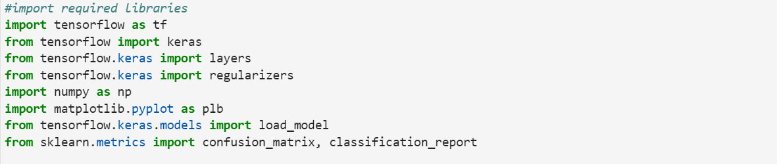
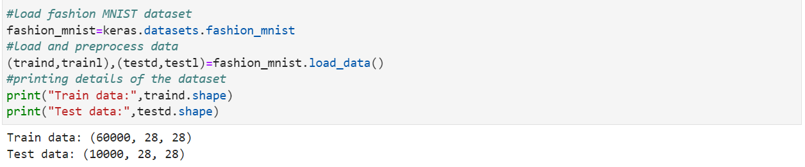
My primary objective in this project was to develop an architecture for CNNs that would perform image classification on the fashion MNIST dataset, and I used Tensorflow to accomplish this. The process is divided into steps such as data analysis, designing the architecture, training the model, and making predictions.
As the initial step the required libraries were imported.
Loading the dataset and data analysis.
The fashion MNIST dataset consists of 60,000 images for the training set and 10,000 images for the testing set where each image is a 28 x 28 size grayscale. The dataset is loaded and then split into training and testing.

Slide 7
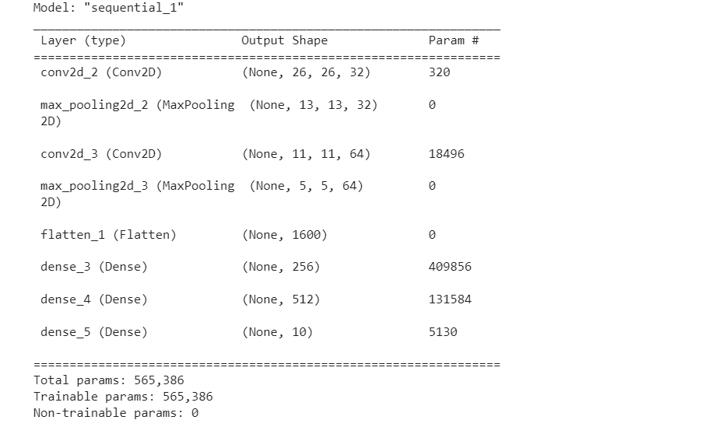
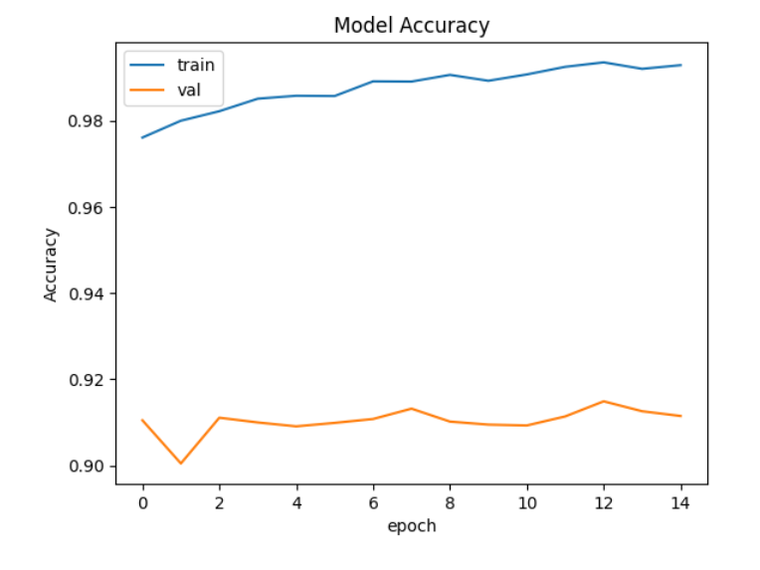
The model was validated and the hyperparameters were tuned at the training stage itself.
Initially, I tested a CNN model without applying any regularizations, and the following results were obtained:
Train accuracy
Validation accuracy
Test accuracy
99.28
91.15
91.14
The architecture

Slide 8
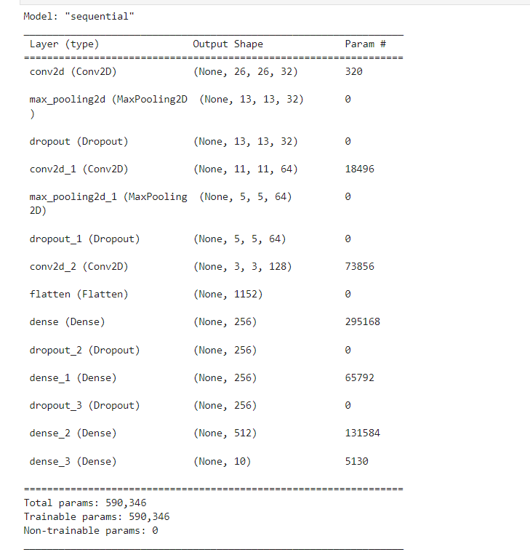
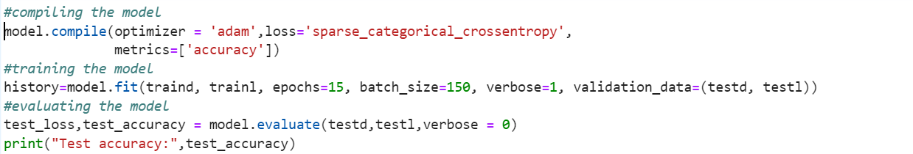
In general, deep learning models typically have a high tendency to overfit (perform better on the training dataset as compared to the validation/test dataset). The above results demonstrate that fact.
A training accuracy of 99% and test accuracy of 91% confirms that model is overfitting.
In order to solve the overfitting issue, Dropout layers were added for regularization, and convolutional and dense layers were added. The modified architecture is :
Compiling and training of the model

Slide 9
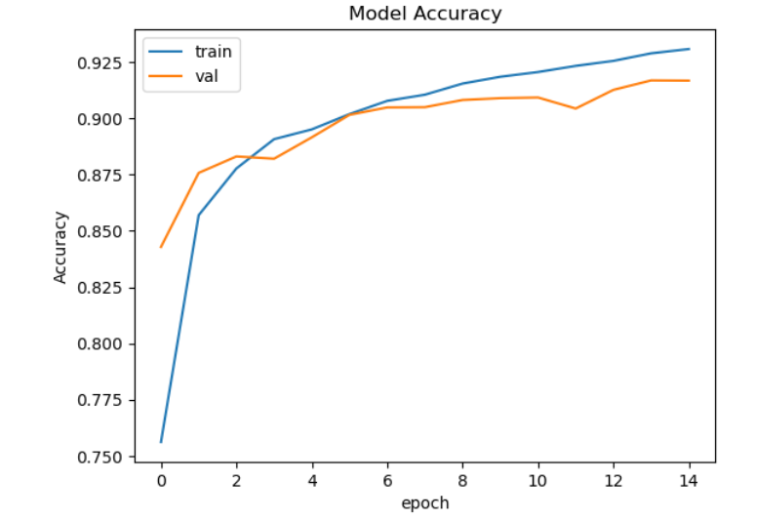
The model is compiled using ‘adam’ optimizer.
The ‘sparse_categorical_crossentropy’ is used as the loss function to minimize the loss.
After compiling the model was trained by adjusting and experimenting with various batch size and number of epochs .
After number of experiments the number of epochs were set to 15 and batch size is set to 150 for better accuracy.
The model is validated based on the test data
After compiling and training the model, the following results were obtained
Train accuracy
Validation accuracy
Test accuracy
93.09
91.68
91.68

Slide 10
The model performed well in terms of training accuracy, with 92%, and test accuracy, with 91%. It is evident that the model is performing well and there is no over fitting. So the model is finalized.
Predictions were made with the model and the resultant array of prediction is obtained.

Slide 11
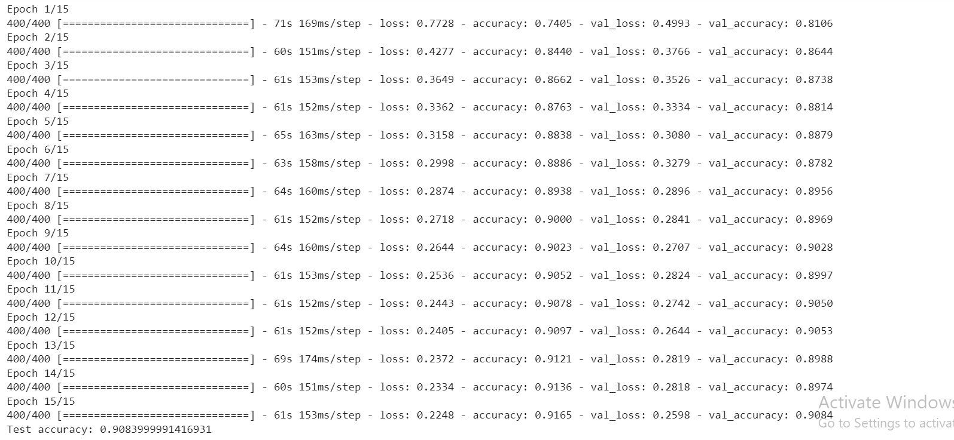
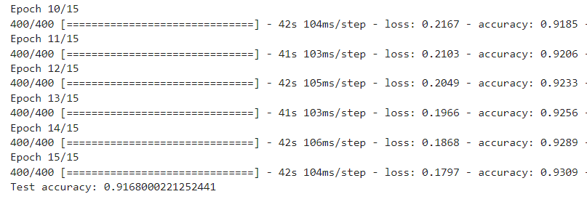
The model was compiled and trained on different platforms, such as Google Colab, Intel Developer Cloud, etc. The model on the Intel DevCloud seemed to perform significantly better than those on other platforms.
63
Average time
90.8
Test accuracy
91.6
Train Accuracy
Model in google colab
41
Average time
91.7
Test accuracy
93.0
Train accuracy
Model in Intel DevCloud

Slide 12
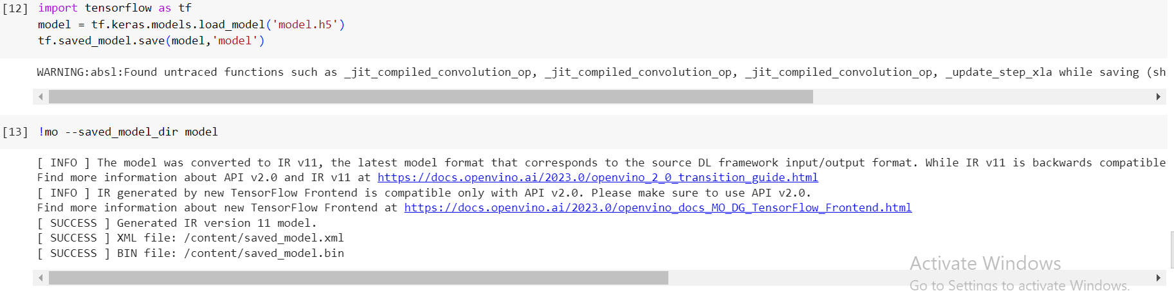
In order for generating better results in the other platform, Intel optimization was used in the model. Model was optimized by using openvino by using the required code and environment. The saved file was converted from .h5 format to the .xml format to perform optimization, and it was successfully done.
However, this operation was not supported in my current jupyter lab environment.

Slide 13
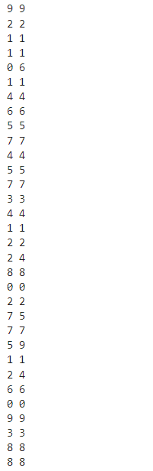
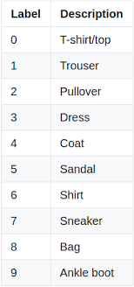
RESULTS
The model was compiled and trained with 15 epochs and a batch size of 150 on the Intel DevCloud platform, and results were obtained. For a better understanding about the results few of the prediction values were printed to analyze the errors.
It was possible to identify which category makes more errors in the prediction by comparing predicted values with the target data.
The pullover(2) and the coat(4) categories are often confused by the model as it have similar structure

Slide 14
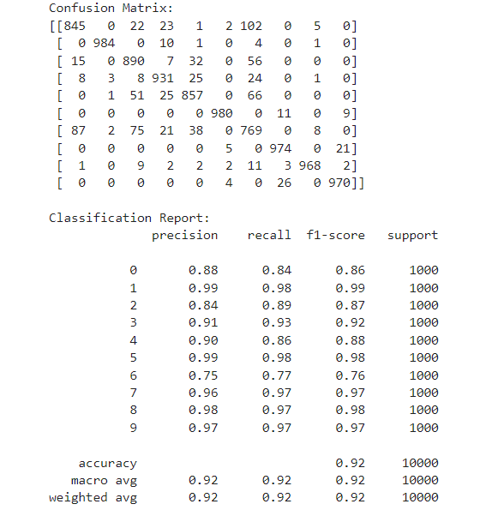
The performance of the model was evaluated on the basis of various evaluation metrics such as accuracy, precision, recall etc.

Slide 15
From the confusion matrix, we can find that the
class 6(Shirt) is often confused with class 0(T-shirt)
Because of their similarity in structures.

Slide 16
CONCLUSION
In conclusion, this project on Fashion MNIST using Convolutional Neural Networks (CNNs) has highlighted the benefits of learning the problem and employing CNNs. In the process of exploring the Fashion MNIST dataset, I gained insight into computer vision and image classification that can be applied to other fields. The effectiveness of CNNs in capturing meaningful patterns and structures within the images resulted in improved accuracy. My skills in building deep learning models for image analysis have increased as a result of this project, which is useful for a variety of applications in different areas of real life. As a whole, it has expanded the knowledge in the field of computer vision and has paved the way for future endeavors into this field.

Slide 17
REFERENCES
LINKS TO SOLUTION
https://rb.gy/vwu4x
https://rb.gy/ahreu
https://rb.gy/k8o8r
https://github.com/Jenat14/intelunnati_Codered
Notes:
In Slide Show mode, click the arrow to enter the PowerPoint Getting Started Center.

